Slide 1
Active Prosthetic Arm
Touch Base:
Aseel Yousef, Ethan Gage, Lihua Diao
Xiaohan Liu

Slide 2
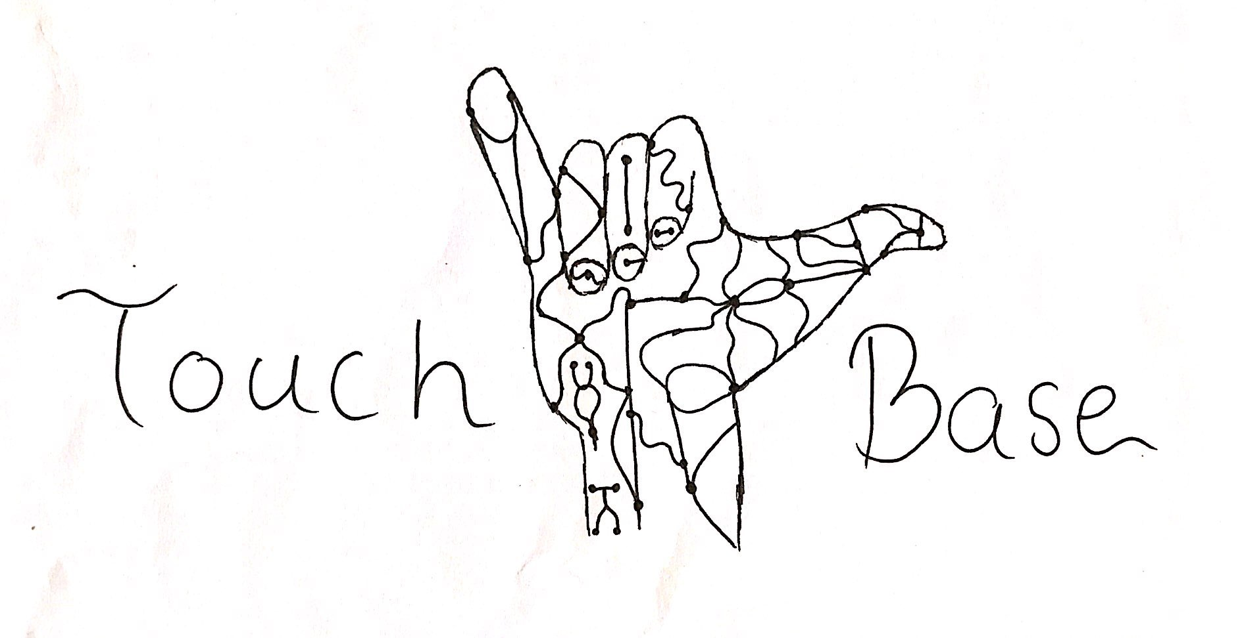
Team Introductions
Team Members:
  Aseel Yousef
  Ethan Gage
  Lihua Diao
  Xiaohan Liu
GTA: Dina Ghanai
Client: Dr. Kyle Winfree

Slide 3
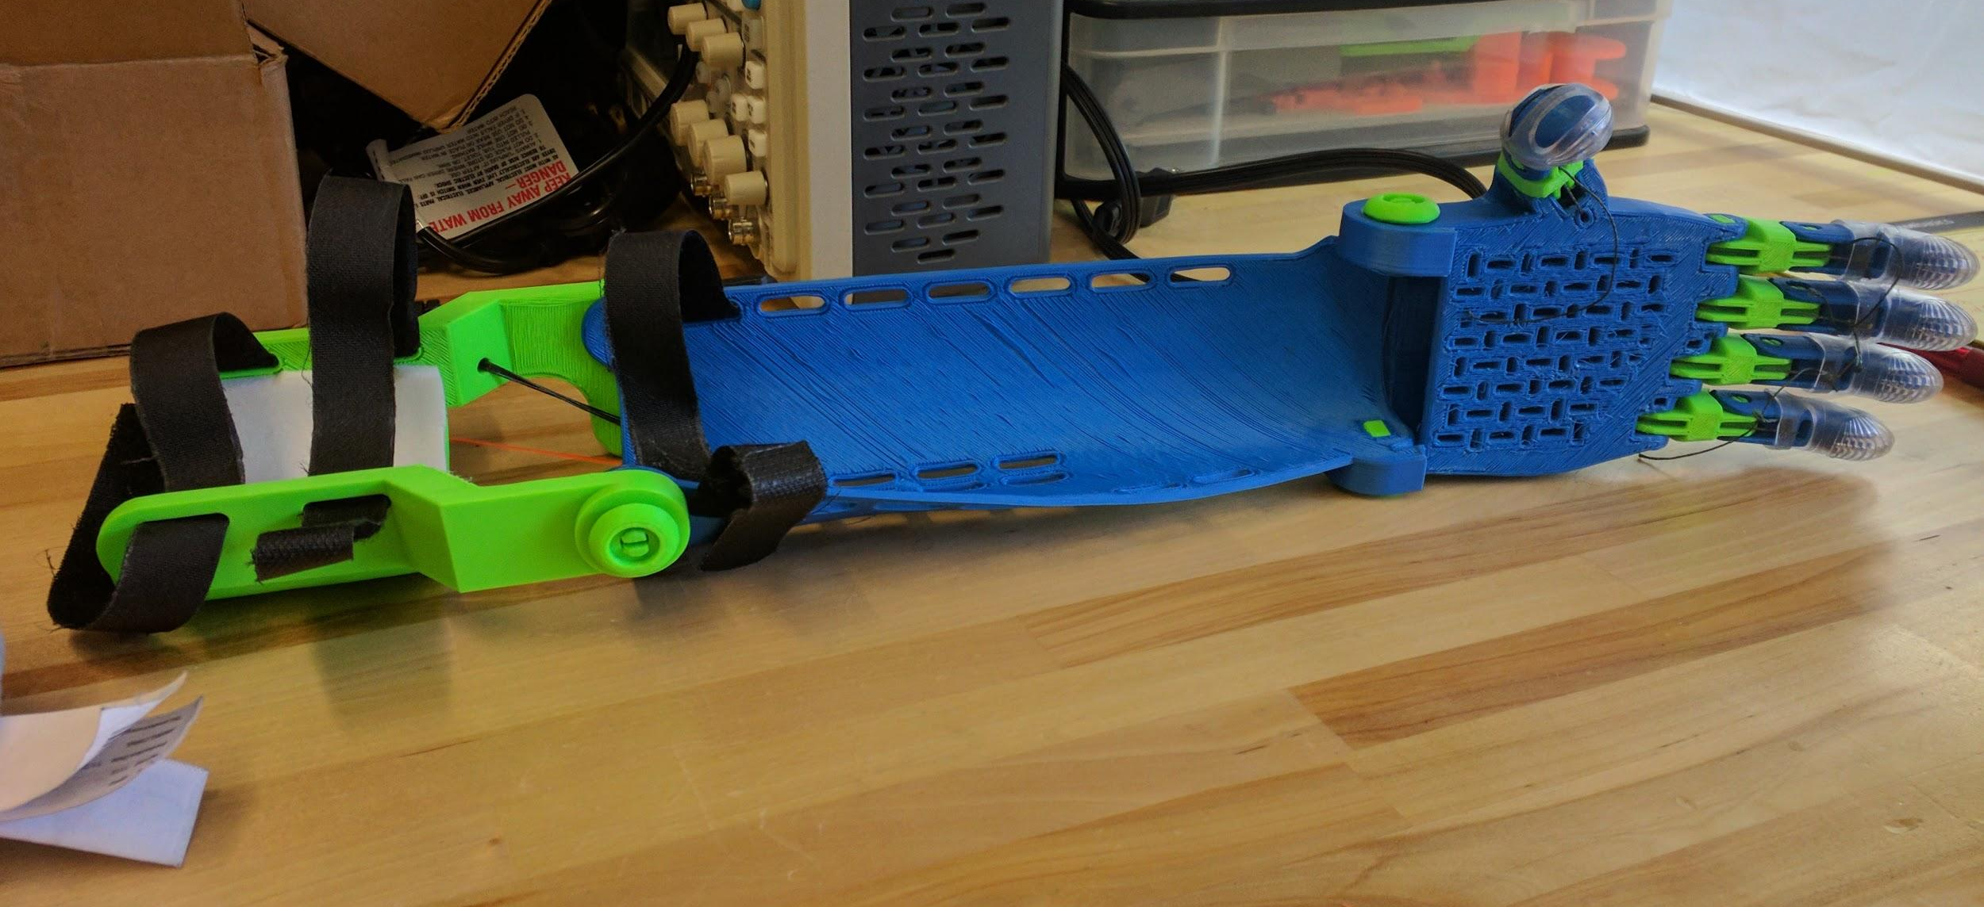
Importance of Project
Flagstaff E-nable chapter:
First open-source active prosthetic to further improve the capabilities of low cost prosthetics.
This project aims to return the sense of touch to those who have lost it, at an affordable rate.
Aseel

Slide 4
Subsystems
User Interface - How will the device be controlled?
  Muscle sensor: Detect muscle activity and transfer signal to the processor.
  Toe-to-thumb control: Pressure sensor control the servo motor.
Processing - How will the device process commands?
  Arduino microprocessor.
Mechanical - Physically accomplishing movement, sensation?
  Servo motor control movement. A sensor is used to detect the position before or after move.
Feedback - How will the device emulate touch?
  Constriction bands: Tighten around the client’s arm proportional to how much a motor has moved, or how much power a motor is exerting.
Power - How will the whole device be powered?
  Quick swap battery pack: A heavier, more powerful supply will be powering the motors, while the Arduino will be powered by a lighter, less powerful power source.
Xiaohan

Slide 5
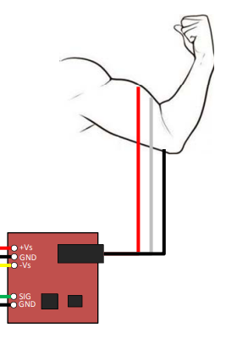
Solutions - Reading Data from Human
During Prototyping:
  We are making use of the MyoWare Muscle Sensor, available on Sparkfun
  This allows us to read an approximation of how much a given muscle is flexed by using biomedical sensors on the surface of the skin.
  Prototype: Reading Muscle Data
MyoWare Muscle Sensor -> Setup
Ethan

Slide 6
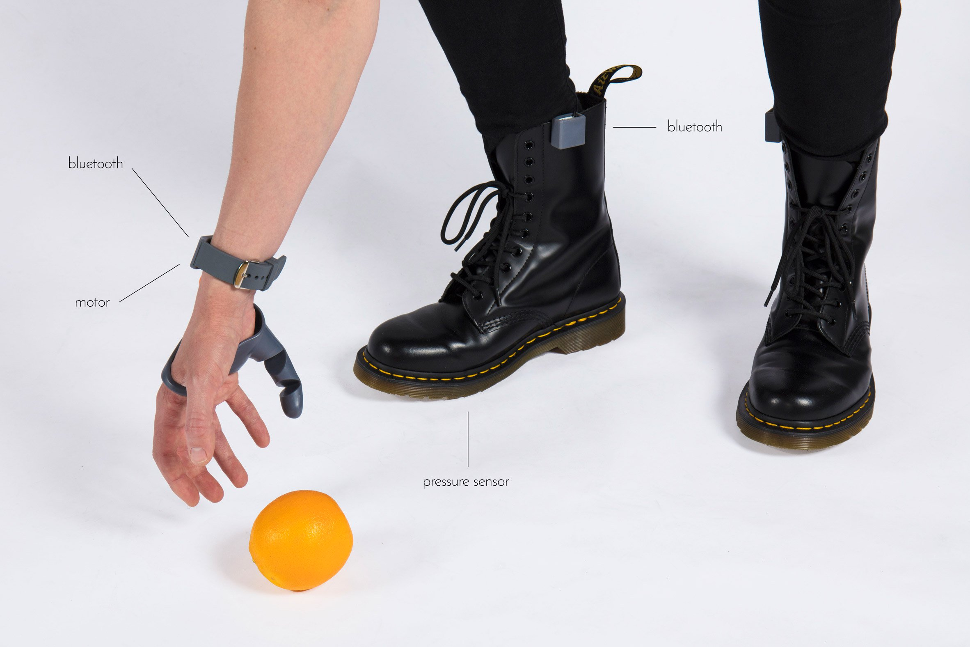
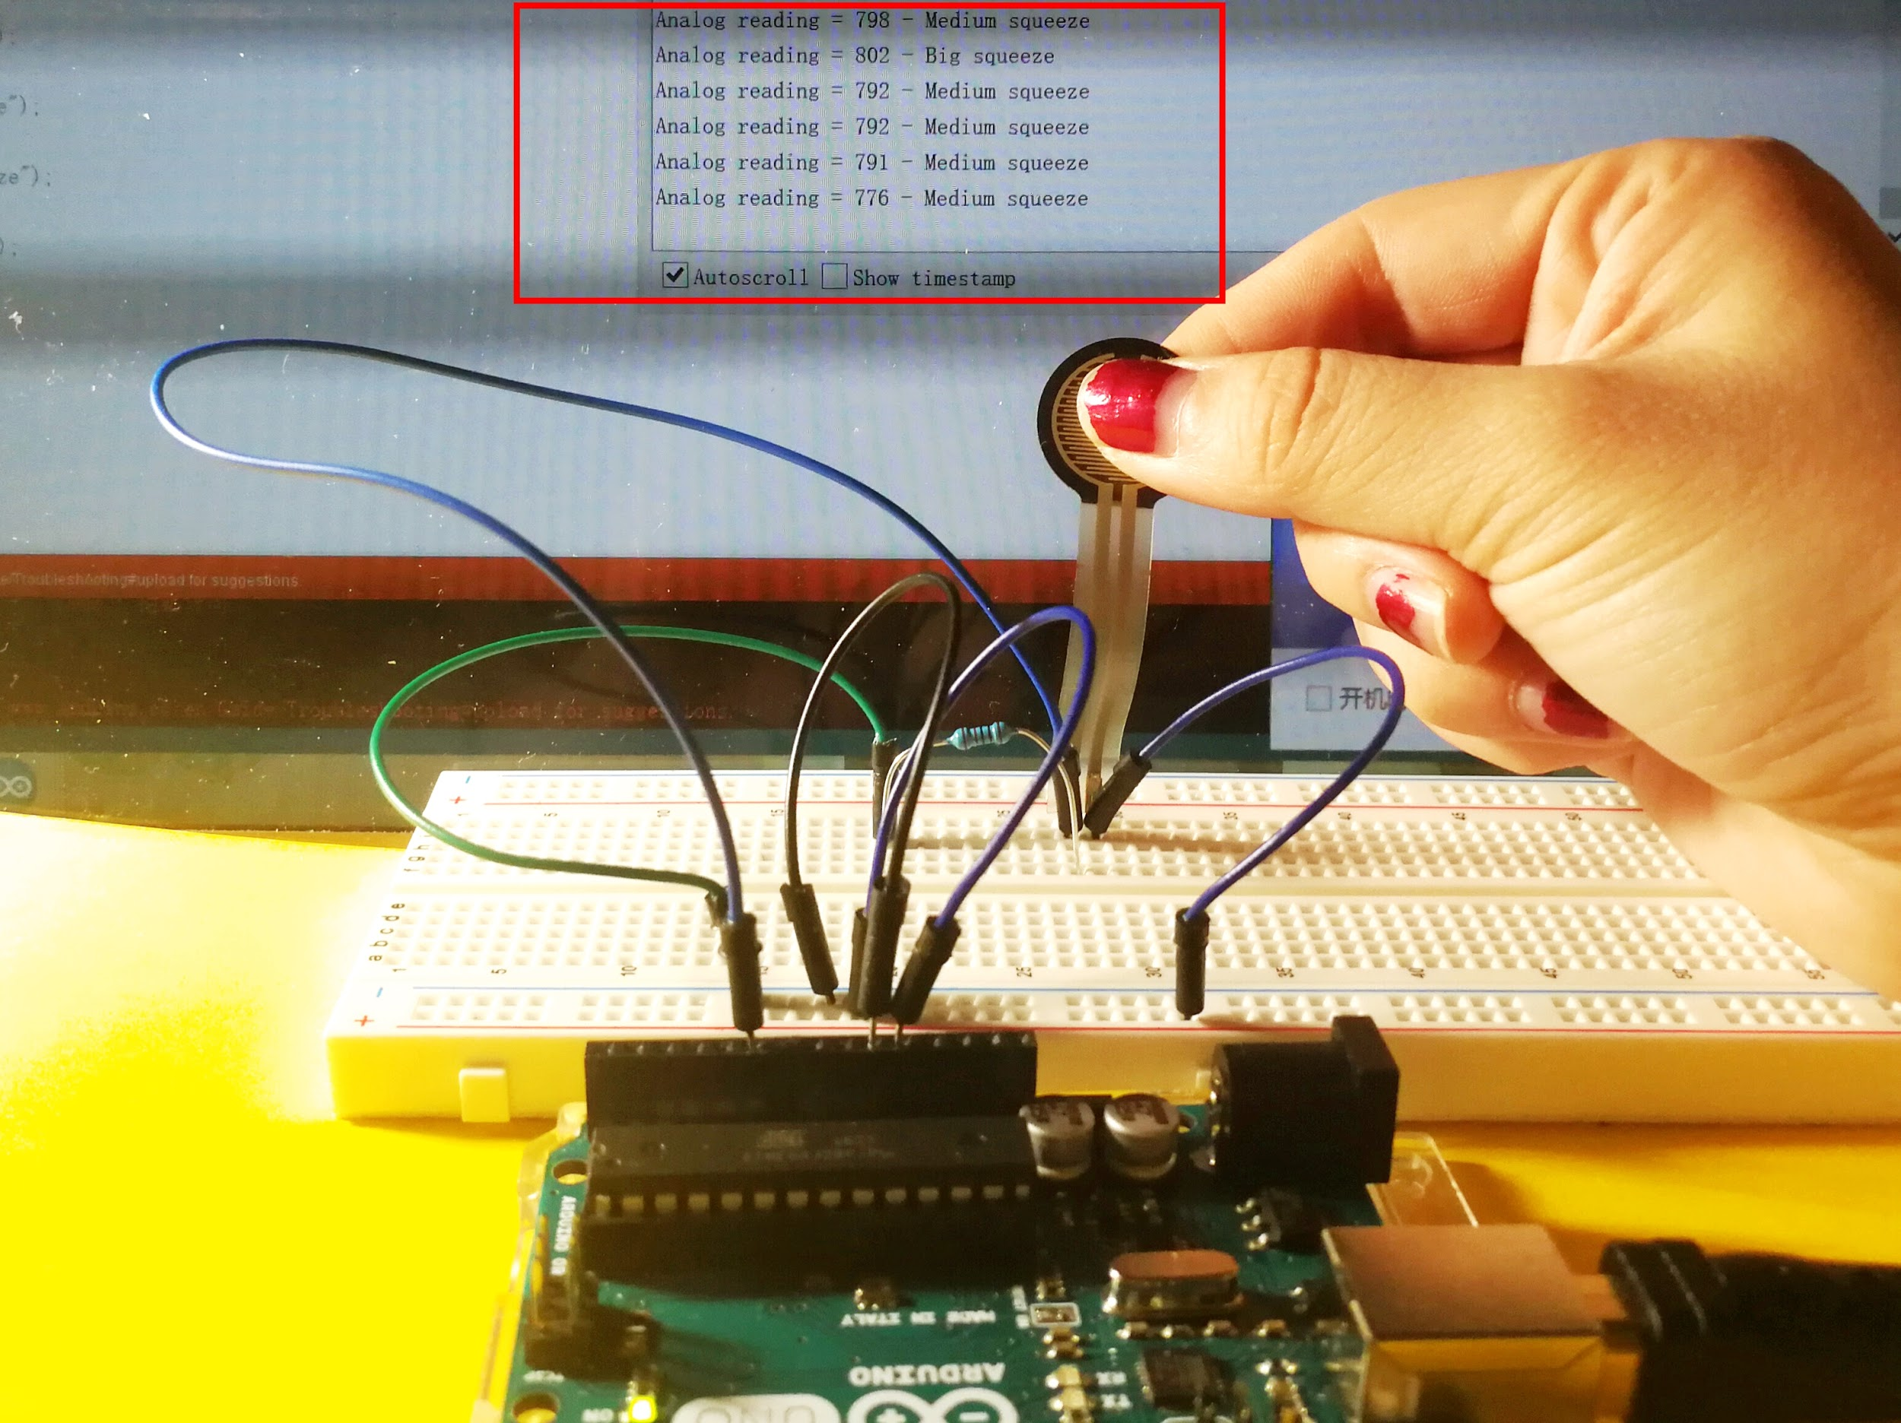
Solutions - Toe to Thumb Control
Other Control
  For toe-to-thumb control, it uses the Bluetooth at foot to enable pressure sensors to transmit signals. The pressure sensor is fitted into the user’s shoes, designed to sit underneath the toes. The thumb is connected by Bluetooth technology, and the sensor activates motors in the prosthesis to move in different directions.
  Prototype: Read Analog Sensor Data
The Third Thumb Project
- Dani Clode Design
Lihua

Slide 7
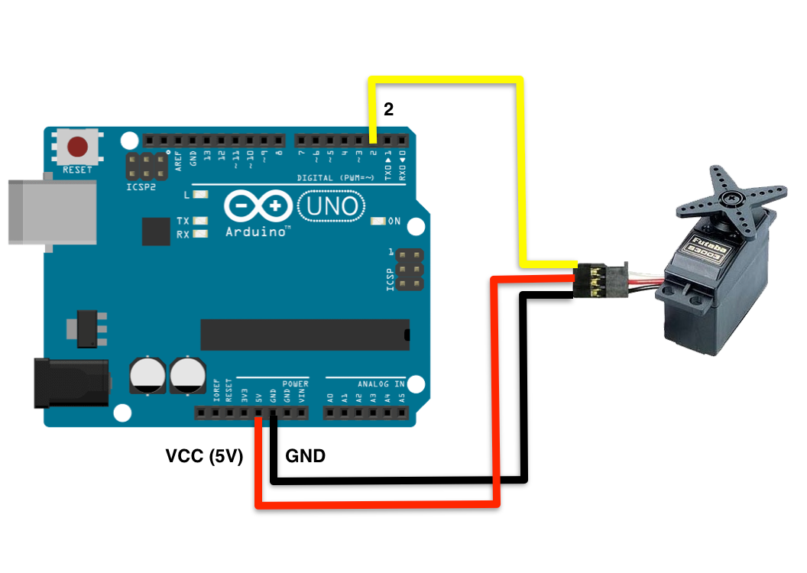
Solutions - Servo Motor Control
Prototype: Control Servo Motor
  Servo motor would be connected to a band
  Servo motor would rotates indicating how much pressure the pressure sensor reads
  The band constricts when the pressure is high, and expands when it is low
Servo Motor Circuit
Aseel

Slide 8
Closing
We will read muscle activation with the muscle sensor
This becomes code to control the hand Servos
For the Toe to Thumb control:
First, the pressure sensors will give data to be transmitted wirelessly
This will be decoded to control the two servos for the thumb.
Ethan Gage

Slide 9
Thank You

